Slide 1
MSCS-532-M20 · ALGORITHMS AND DATA STRUCTURES — COURSE PROJECT
Developing and Optimizing Data Structures
for an E-Commerce Order Platform in Python
GROUP 2
Mahesh Gaire · Basanta Ghorashainee · Sai Prasanth Chowdary Moparthi
Mayurkumar Bhavikkumar Patel · Xhon Pelushi
University of the Cumberlands · Dr. Michael Solomon
July 17, 2026
MSCS-532 · Group 2 — E-Commerce Order Platform
1
Notes:
Good afternoon. We are Mahesh Gaire, Basanta Ghorashainee, Sai Prasanth Chowdary Moparthi, Mayurkumar Bhavikkumar Patel, and Xhon Pelushi, and this is our group's course project for Algorithms and Data Structures: designing, implementing, and optimizing the data-structure core of an e-commerce order platform in pure Python. Members of our group work in the e-commerce industry, so we chose a problem where data-structure decisions are not academic: they show up directly as page latency and lost sales. Each of us will present one part of the project. Over the next twenty minutes we'll walk through the design, the proof-of-concept implementation and its live browser portal, the testing, and the benchmark results at one hundred thousand products — including one honest result where theory promised a win and the interpreter took it back.

Slide 2
01 · THE PROBLEM
One Shopping Session, Six Access Patterns
A shopper's visit is a sequence of queries:
typing → prefix search
filtering → range query
recommendations → graph traversal
checkout → exact lookup + FIFO
dashboards → top-k/priority selection
No single container serves all of these well
Design problem = composition of specialized structures
MSCS-532 · Group 2 — E-Commerce Order Platform
2
Notes:
Every page of an online store is secretly a data-structure benchmark. In one session a shopper triggers a prefix query when they type into the search box, an ordered range query when they filter by price, a graph query when they read the also-bought panel, exact-key lookups at checkout, and a top-k selection on every dashboard. These access patterns are mutually hostile: a hash table cannot report an ordered range, and a sorted structure pays for its order on every insert. So the real design problem isn't picking one structure — it's composing several specialists and keeping them consistent.

Slide 3
02 · DESIGN
Design: Six Structures, One Source of Truth
Hash table (chaining, FNV-1a, resizing) — product catalog
Trie — search / autocomplete, every word indexed
Binary search tree — price-band queries
Weighted adjacency-list graph — co-purchase recommendations
Binary max-heap — best sellers & low-stock alerts
Circular-buffer queue — order fulfilment (FIFO)
Rule: records live only in the catalog;
all other structures store SKUs, resolved in O(1)
MSCS-532 · Group 2 — E-Commerce Order Platform
3
Notes:
Phase one mapped each workload to the structure asymptotically built for it: a separate-chaining hash table as the catalog, a trie for autocomplete, a binary search tree keyed on price, a weighted adjacency-list graph for co-purchases, a max-heap for the dashboards, and a circular-buffer queue for fulfilment. The integration rule that keeps six structures consistent is a single source of truth: product records live only in the hash table, and every other structure stores just SKU keys that resolve through the catalog in constant time. Nothing is duplicated, so the indexes can never disagree.

Slide 4
02 · DESIGN
Architecture: Commerce Feeds the Recommendations
ECommerceSystem facade — methods are business actions
add_product → catalog + trie + price tree
place_order → queue; fulfil → stock, sales, graph edges
recommend_for → graph neighbors ranked by weight
Fulfilment is the causal link:
every processed order strengthens co-purchase edges
recommendations improve as a side effect of commerce
Atomic failure: validate all line items before any commit
MSCS-532 · Group 2 — E-Commerce Order Platform
4
Notes:
The facade class wires the structures together, and its methods are business actions, not data-structure calls. Adding a product writes three indexes at once. The interesting method is fulfilment: it dequeues the oldest order, validates every line item against stock before committing anything — so an out-of-stock failure is atomic — then decrements stock, increments sales, and feeds every pair of items in the order into the co-purchase graph. That last step is the causal heart of the system: recommendations get better as a side effect of selling things.

Slide 5
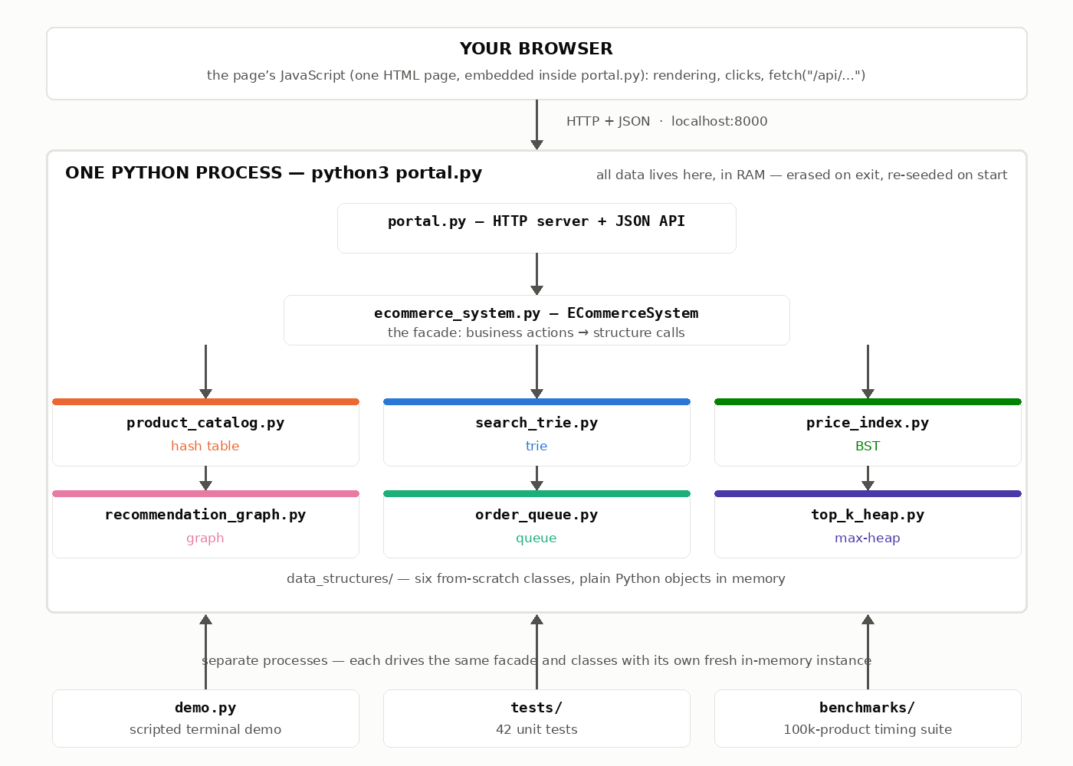
02 · DESIGN
The Whole System on One Page
MSCS-532 · Group 2 — E-Commerce Order Platform
5
Notes:
Here is the whole system on one page. At the top, the browser — one HTML page whose JavaScript talks JSON to a single Python process over localhost. Inside that process, portal dot py is just an HTTP server; every request becomes one call on the facade, and the facade drives the six structure modules — each in its own file, each color-matched to the panel it serves in the portal you'll see shortly. All data lives in this process's memory: stop it and the state is gone, start it and it re-seeds identically. And note the bottom row — the demo script, the forty-two tests, and the benchmark suite are separate processes driving the same facade and the same classes, which is why proving correctness and measuring performance never interferes with the running store.

Slide 6
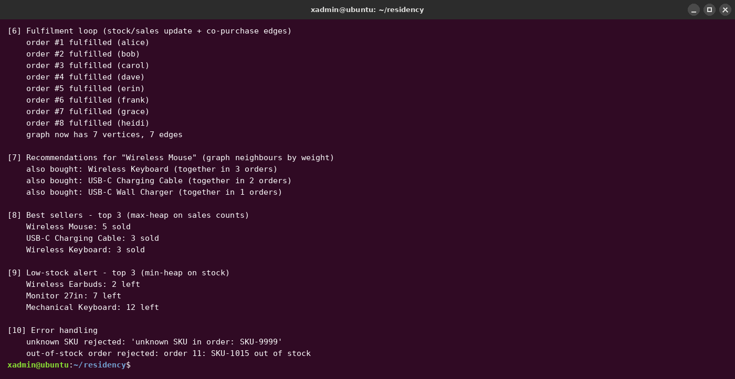
03 · PROOF OF CONCEPT
Proof of Concept: One Scripted Session, End to End
MSCS-532 · Group 2 — E-Commerce Order Platform
6
Notes:
Phase two implemented all six structures from scratch — no dict or heapq shortcuts for the mechanics under study — and proved they cooperate with a scripted end-to-end session. What you see here is the second half of that demo. Eight orders flow through the queue, and immediately afterward the also-bought panel for the wireless mouse ranks the wireless keyboard first with weight three — because exactly three of the eight orders contained both. The dashboards reflect the decremented stock, and the last step deliberately triggers the error paths: an unknown SKU is rejected at checkout, and an order for an exhausted product fails cleanly at fulfilment.

Slide 7
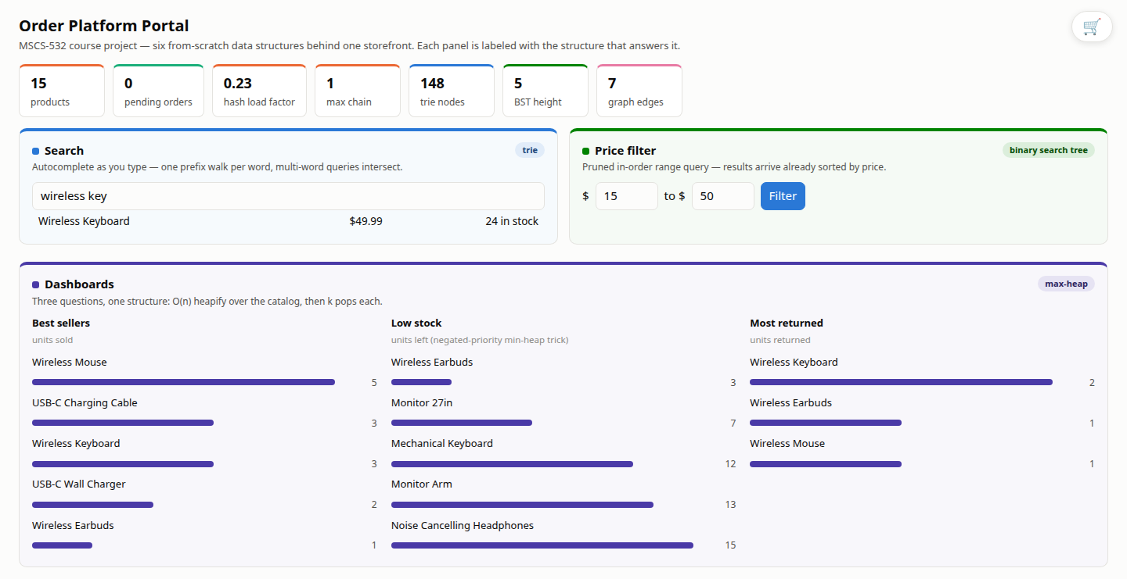
04 · LIVE PORTAL
Proof of Concept, Live: The Browser Portal
MSCS-532 · Group 2 — E-Commerce Order Platform
7
Notes:
The proof of concept also runs live in the browser. A single-file portal — standard-library HTTP server, still zero dependencies — serves this storefront, and every panel is answered by exactly one structure and painted in its color: the search box walks the trie on every keystroke, the price filter is a pruned tree traversal, the catalog table is the hash table itself, the also-bought panel reads the co-purchase graph, the cart drains through the FIFO queue, and the three dashboards at the bottom — best sellers, low stock, and most returned — are one max-heap asked three different questions. The portal also adds a returns workflow: an accepted return restocks the catalog, cumulative returns are capped at units sold, and the most-returned dashboard keeps dissatisfaction visible next to demand. In the live demo we will place an order, watch the pending counter drain, and watch a return climb that dashboard.

Slide 8
04 · LIVE PORTAL
Portal Metrics: The Structures' Vital Signs
Live diagnostics, one tile per structure — color-coded to its panel
Load factor 0.23 = 15 records / 64 buckets — doubling past 0.75 is what keeps lookups O(1)
Max chain 1 — FNV-1a spreads keys well (111 when resizing is disabled at 100k products)
BST height 5 vs ~4 ideal — near-balanced; sorted inserts would make it 15
148 trie nodes — shared prefixes stored once; 7 graph edges grow with every fulfilled order
MSCS-532 · Group 2 — E-Commerce Order Platform
8
Notes:
The strip across the top of the portal is the structures' vital signs, read live at every refresh. The load factor is fifteen records over sixty-four buckets — point two three — and the table doubles its buckets past point seven five, which is exactly what keeps lookups constant-time. Max chain one means every SKU sits alone in its bucket; freeze the resizing at benchmark scale and that number climbs to a hundred and eleven. The tree height of five is near the balanced ideal of four for fifteen prices — had prices arrived sorted it would be fifteen, a linked list. These three numbers decide whether our complexity claims actually hold, so the portal keeps them visible while you shop.

Slide 9
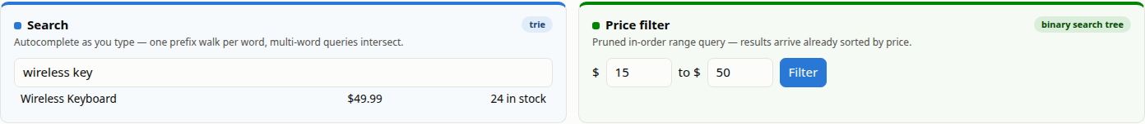
04 · LIVE PORTAL
Live Search Is a Trie Walk; the Filter Is a Pruned BST
Every keystroke = one prefix walk — cost grows with the prefix, never with the catalog
“wireless key” = two walks intersected → only the Wireless Keyboard survives both
$15–$50 = pruned in-order traversal — whole subtrees outside the band are never visited
Results arrive already sorted by price — no sorting step exists anywhere in the system
MSCS-532 · Group 2 — E-Commerce Order Platform
9
Notes:
Here are the two query panels doing real work. The search box fires on every keystroke, and each query is one walk down the prefix tree, so its cost depends on the length of what you typed, never on how big the store is. The screenshot shows the interesting case: wireless-space-k-e-y is two walks whose results are intersected, so only the Wireless Keyboard survives both word filters. Next to it, the price filter answers fifteen-to-fifty dollars with a pruned in-order traversal — subtrees that cannot intersect the band are never visited — and because in-order visits prices in ascending order, the results come back sorted for free.

Slide 10
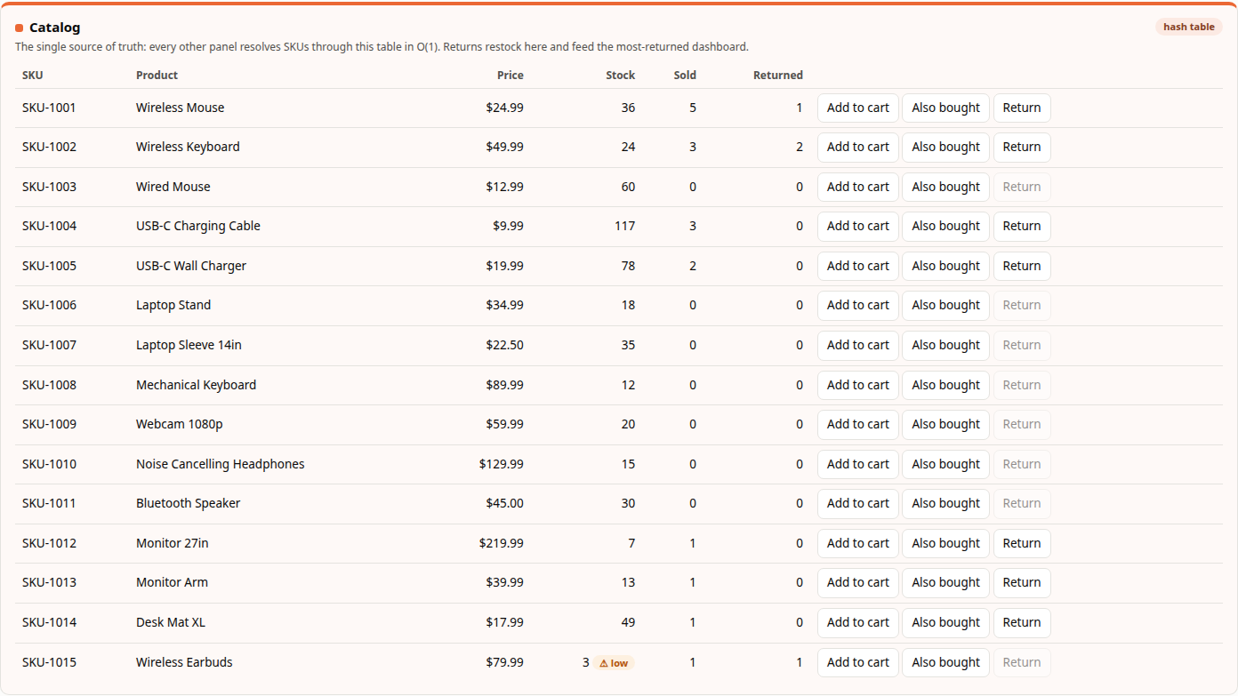
04 · LIVE PORTAL
The Catalog Panel Is the Hash Table
Single source of truth — every other panel resolves SKUs here in O(1)
FNV-1a hash → bucket → short chain scan
⚠ low badge at ≤ 5 units — the same signal the low-stock dashboard ranks
Return enabled only while Returned < Sold — the cumulative cap
One write updates every view — indexes can never disagree
MSCS-532 · Group 2 — E-Commerce Order Platform
10
Notes:
The catalog table is the hash table, rendered. Every other panel on the page stores only SKU strings and resolves them through this table in constant time — that is the single-source-of-truth rule that keeps six structures consistent. The columns tell the store's story: stock falls at fulfilment and rises on returns, sold counts only fulfilled units, and the return button is enabled only while returned is less than sold — you cannot return what never sold, and you cannot return the same unit twice; the backend enforces the same cumulative cap. Click return on the keyboard and three views move at once — this table, the stock badge, and the most-returned dashboard — from one write to one record.

Slide 11
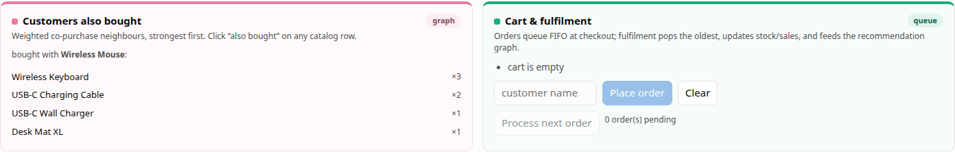
04 · LIVE PORTAL
Recommendations Read the Graph; the Cart Drains the Queue
×3 = mouse + keyboard appeared together in three fulfilled orders — weights are order counts
Fulfilment adds or strengthens edges → commerce improves the recommendations, immediately
Checkout validates and enqueues (FIFO) — stock is untouched until fulfilment
Fulfilment validates every line item, then commits atomically — a failed order changes nothing
MSCS-532 · Group 2 — E-Commerce Order Platform
11
Notes:
The bottom row pairs cause and effect. On the left, the also-bought panel reads the co-purchase graph: the keyboard's weight of three means exactly three fulfilled orders contained mouse and keyboard together. On the right is where those weights come from — the cart enqueues orders first-in-first-out, and processing an order is a strict validate-then-commit: every line item is checked against stock before anything mutates, so a failure is atomic, and only a successful commit decrements stock, increments sales, and feeds every item pair into the graph. That causal loop — selling things makes the recommendations better — is the integration claim of the whole project, and here you can watch it happen.

Slide 12
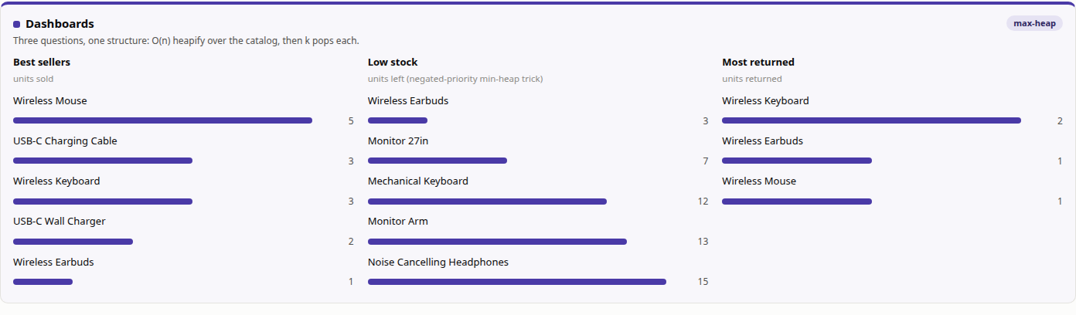
04 · LIVE PORTAL
Three Dashboards, One Max-Heap
O(n) bottom-up heapify over the catalog, then k pops — O(n + k log n) per dashboard
Low stock: priorities pushed negated — the classic min-heap trick
Most returned tracks dissatisfaction, Sold tracks demand — kept as separate signals
MSCS-532 · Group 2 — E-Commerce Order Platform
12
Notes:
All three dashboards are the same data structure asked three different questions. Each list heapifies the whole catalog bottom-up — linear time, cheaper than sorting — then pops just the top five. Low stock wants the smallest values from a max-heap, so priorities go in negated, the classic trick. And most-returned ranks the returns counters we added with the portal: a return puts the unit back in stock but never subtracts from sold, so best sellers keeps measuring demand while most-returned measures dissatisfaction — a product high on both lists is exactly what a merchandiser needs to see.

Slide 13
Demo time!
the portal, live — http://localhost:8000
MSCS-532 · Group 2 — E-Commerce Order Platform
13
Notes:
That's the portal on slides — now let's show it to you running. We'll open the storefront, search as we type, place and process an order, and watch a return climb the most-returned dashboard, with the metrics strip updating live. [Switch to the browser at localhost:8000; the click sequence is in the demo run sheet.]

Slide 14
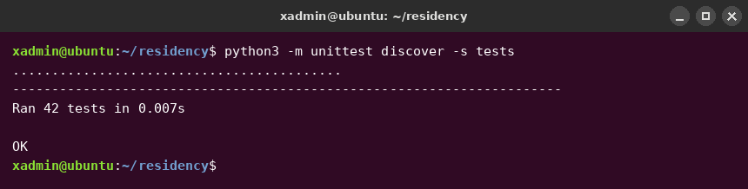
05 · TESTING
Correctness: 42 Tests Aimed at the Failure Modes
Hash table filled through multiple resizes, re-verified
Queue drained across the circular wraparound boundary
BST range query cross-checked vs brute force (1,000 prices)
Heap top-25 vs full sort (2,000 random entries)
Failed order commits nothing — atomicity test
Returns capped cumulatively — never exceed units sold
Input validation at every boundary (typed exceptions)
MSCS-532 · Group 2 — E-Commerce Order Platform
14
Notes:
Correctness rests on forty-two unit tests, and they aim at each structure's specific failure mode rather than the happy path. The hash table is grown through several resizes and every record re-verified. The circular buffer is drained across its wraparound boundary. The tree's range query is cross-checked against brute force on a thousand random prices, the heap against a full sort. And the integration tests verify the atomicity property: when an order fails on stock, nothing else in that order has been touched. Every module also validates inputs at the boundary, so bad data raises a typed exception before any state mutates.

Slide 15
06 · BENCHMARKS
Phase 3: Scaling Method
Catalogs of 1k → 100k products, 20k-order streams
Realistic names (shared prefixes) — the trie earns nothing from random strings
Quadratic popularity skew — hub products emerge, like real stores
Best-of-5 timings (perf_counter), peak memory (tracemalloc)
Every structure measured against a naive baseline
fixed-capacity hashing, linear scans, full sorts
MSCS-532 · Group 2 — E-Commerce Order Platform
15
Notes:
Phase three turned to performance. The dataset generator builds catalogs from one thousand to one hundred thousand products with adjective-noun names, so the trie faces realistic shared prefixes, and an order stream with a quadratic popularity skew, so hub products emerge the way they do in real stores. Timings are best-of-five wall clock, memory is peak tracemalloc, and — this is the discipline of the whole phase — every specialized structure has to justify itself against the naive baseline a simpler system would use: a fixed-capacity table, a linear scan, a full sort.

Slide 16
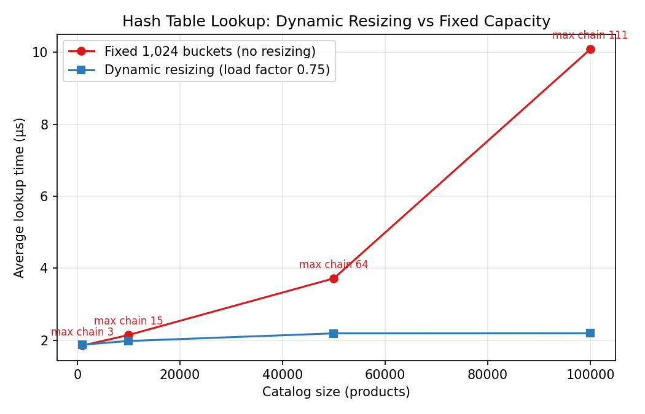
06 · BENCHMARKS
Result: Resizing Keeps Lookups Flat
4.6×
faster lookups with load-factor resizing than a fixed-capacity table at 100k products
Resizing: ~2.2 µs per lookup — flat, 1k → 100k
Fixed 1,024 buckets: degrades to 10.1 µs
max collision chain reaches 111 entries
The O(n/m) arithmetic of chained hashing, made visible
MSCS-532 · Group 2 — E-Commerce Order Platform
16
Notes:
The first headline result is the catalog. With load-factor resizing — the bucket array doubles past 75 percent occupancy — lookups sit flat at about two microseconds across two orders of magnitude of catalog size. Freeze the same table at a thousand buckets and it degrades linearly to ten microseconds, with collision chains a hundred and eleven entries long. That's a five-fold penalty for skipping one optimization, and it's exactly the O of n over m arithmetic from lecture, made visible in a chart.

Slide 17
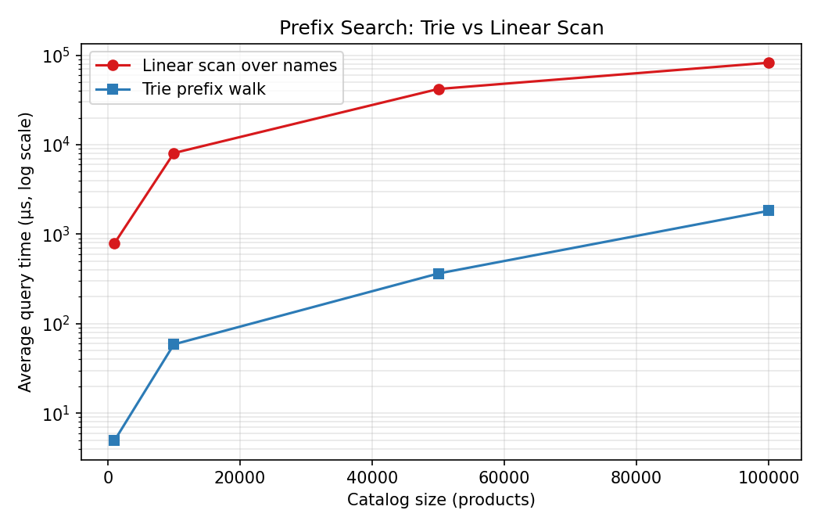
06 · BENCHMARKS
Result: The Trie Wins by 45×
45×
faster prefix search than a linear scan at 100k products
Linear name scan: 82 ms per query at 100k products
Trie prefix walk: 1.83 ms — 45× faster
Cost depends on prefix + matches, not catalog size
Price-band query: pruned BST beats scan 5.7×
Both gaps widen as the catalog grows
MSCS-532 · Group 2 — E-Commerce Order Platform
17
Notes:
Search is the largest payoff. A linear scan touches every product name on every keystroke — eighty-two milliseconds per query at full scale, which is an unusable autocomplete. The trie answers the same query in under two milliseconds, forty-five times faster, and the gap widens with catalog size because the trie's cost depends only on the prefix length and the matches, not on how big the store is. The price tree shows the same shape in milder form: the pruned in-order traversal beats scan-and-sort by nearly six times on a five-percent price band.

Slide 18
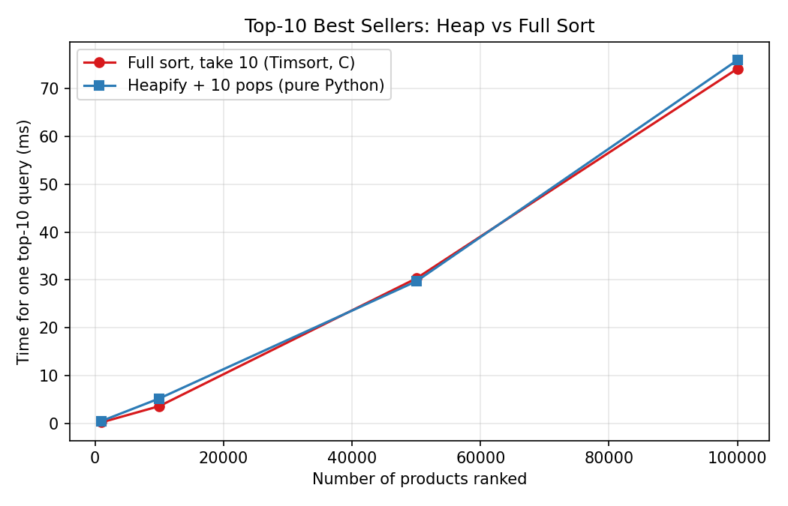
06 · BENCHMARKS
The Honest Result: Asymptotics vs the Interpreter
Heap top-10: O(n + k log n) — should beat O(n log n) sort
Measured: pure-Python heap ≈ ties C-implemented Timsort
every sift-down comparison runs in the interpreter
Constant factors consumed the asymptotic advantage
Heap kept for incremental updates, not cold rankings
Lesson: measure optimizations in their environment
MSCS-532 · Group 2 — E-Commerce Order Platform
18
Notes:
And here is the result we're proudest of reporting, because it went against us. Top-ten-best-sellers from a heap is order n plus k log n — asymptotically better than fully sorting. Measured, the pure-Python heap merely ties Python's built-in sort at every size, because Timsort executes in C while every one of my sift-down comparisons executes in the interpreter. The constant factors ate the asymptotic advantage. The heap stays in the design for what the cold benchmark doesn't measure — incremental updates without re-sorting — but the lesson stands: you measure optimizations in the environment they'll run in, or the environment will measure them for you.

Slide 19
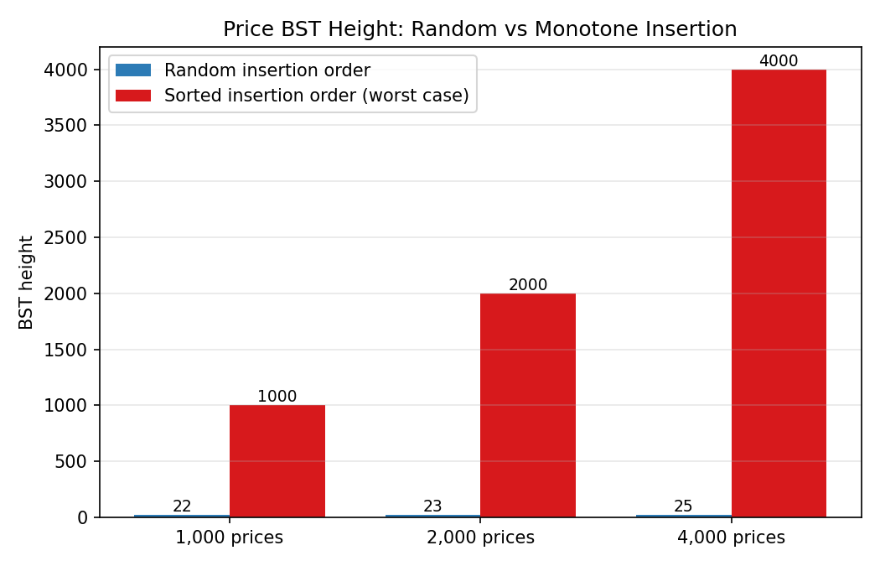
06 · BENCHMARKS
Stress Tests: Predicted Failures, Observed on Cue
Monotone price load: BST height 4,000 vs 25 (random)
the documented worst case, built deliberately
iterative traversal survives where recursion would overflow
Flash-sale load: 20k orders vs 1k-product catalog
9,413 atomic rejections, zero corrupted line items
End to end: ~44k orders/s, ~65 MB at 100k products
MSCS-532 · Group 2 — E-Commerce Order Platform
19
Notes:
Two stress tests target the weak points the design phase wrote down. Loading the price tree with strictly increasing prices — a sorted supplier file — collapses it to a linked list: height four thousand versus twenty-five for the same prices in random order. The queries survive only because traversal is iterative; recursion would overflow Python's stack, which validates that early implementation decision. Second, replaying twenty thousand orders against a deliberately tiny catalog simulates a flash sale: nine and a half thousand orders are rejected, every rejection atomic, no line item corrupted. And end to end, the platform sustains about forty-four thousand orders per second in sixty-five megabytes.

Slide 20
07 · CONCLUSIONS
Conclusions
Composition beats generality — six specialists, one O(1) source of truth
Optimizations must be measured: resizing repaid 5×, the heap's textbook win didn't survive C vs interpreter
Worst cases written down at design time became cheap tests
Future: self-balancing price tree, edge decay in the graph, radix-compressed trie
Code, tests, benchmarks, data: github.com/xhon-pelushi/2026-Summer-Algorithms-and-Data-Structures-MSCS-532-M20
Thank you — questions?
MSCS-532 · Group 2 — E-Commerce Order Platform
20
Notes:
Three conclusions travel beyond this project. First, composition beats generality: the speed comes from routing each workload to the right specialist behind a constant-time source of truth — the same architecture production retailers run. Second, optimizations are empirical claims: resizing repaid itself five-fold, the heap's textbook advantage did not survive the interpreter, and only measurement tells those apart. Third, worst cases documented at design time became cheap tests later — the tree collapse and the flash sale both arrived exactly as predicted. Future work is self-balancing for the price tree, edge decay for the graph, and radix compression for the trie. Everything — code, forty-two tests, benchmarks, and raw data — is in the course repository. Thank you; we're happy to take questions.

